Slide 1
Algorithm techniques

Slide 2
heuristics

Slide 3
heuristics
Sometimes doing something the perfect (most optimal) way is not feasible (or possible)
Maybe not enough computational resources
Maybe not enough time
Maybe you can get a good enough solution without the extra time or effort

Slide 4
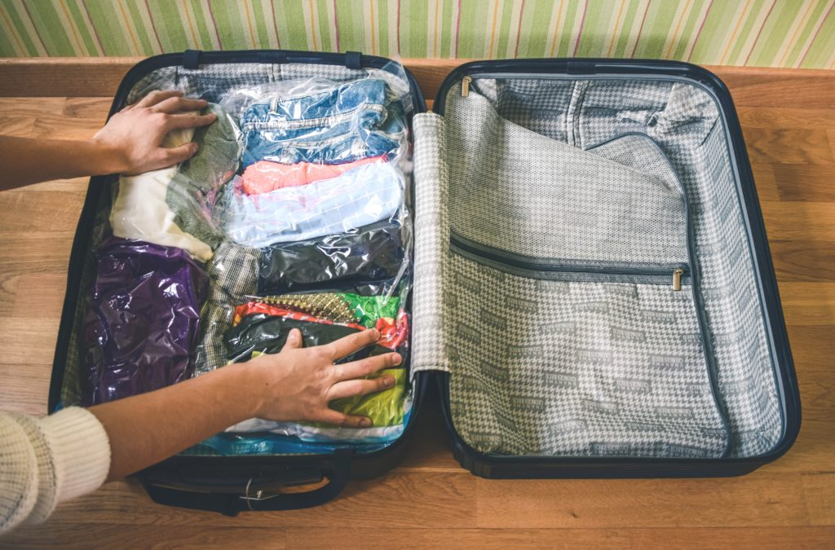

heuristics
EXAMPLE: Goal is to have clothes when you go on a vacation and you are leaving in 30 minutes.
NO TIME TO DO THIS:
AT LEAST YOU WILL HAVE CLOTHES:

Slide 5
heuristics
Algorithms that use a heuristic use a technique that willingly accepts a non-optimal or less accurate solution in order to improve execution speed.
You still get a satisfactory solution.
From Wikipedia: “A heuristic technique (/hjʊəˈrɪstɪk/; Ancient Greek: εὑρίσκω, "find" or "discover"), often called simply a heuristic, is any approach to problem solving or self-discovery that employs a practical method, not guaranteed to be optimal, perfect, logical, or rational, but instead sufficient for reaching an immediate goal.”

Slide 6
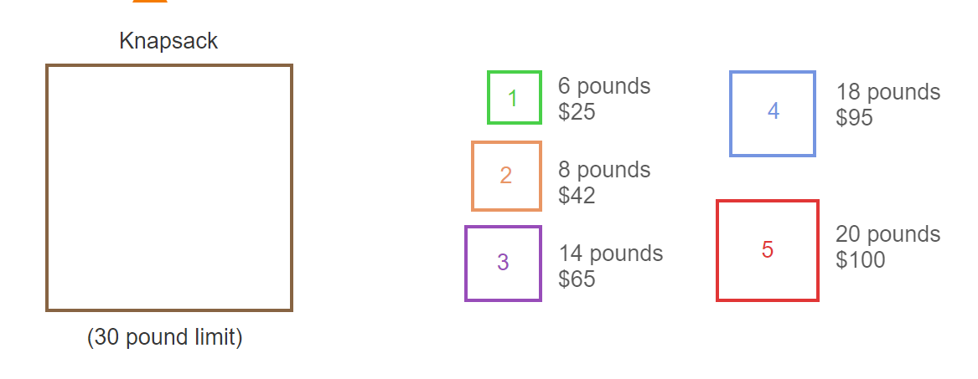
Heuristics: Knapsack Problem
Knapsack problem is an example where a heuristic technique is more feasible, but not optimal.

Slide 7
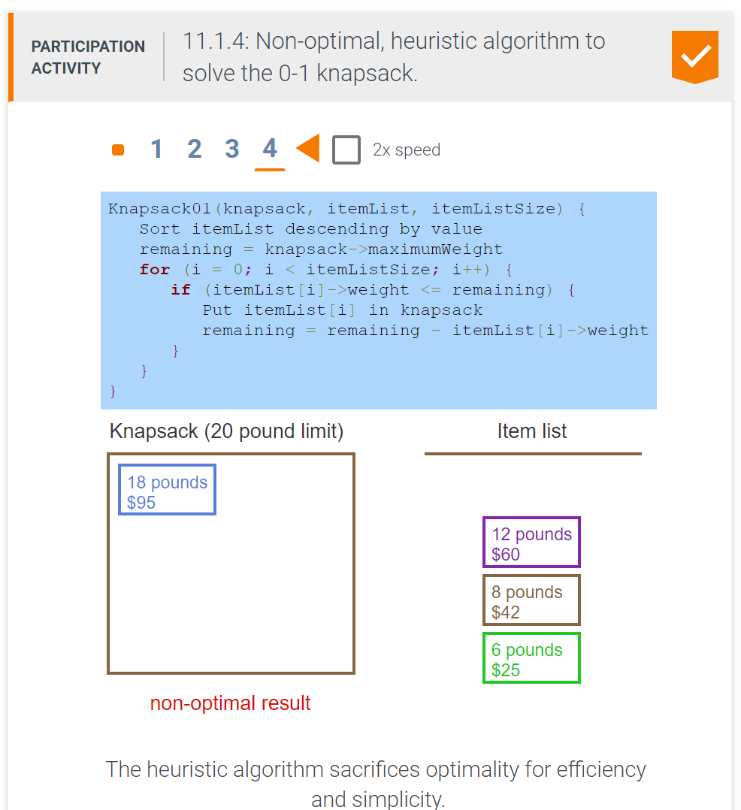
Heuristics: Knapsack Problem

Slide 8
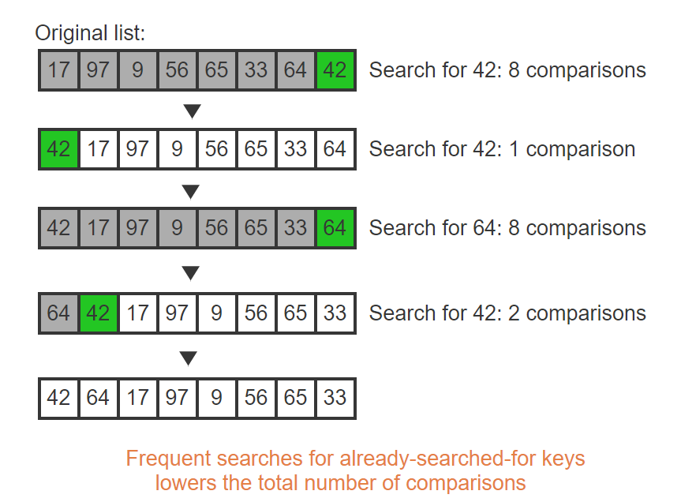
Heuristics: self-adjusting
Adjust the data structure during algorithm.
Move-to-front self-adjusting search example--------------------→

Slide 9
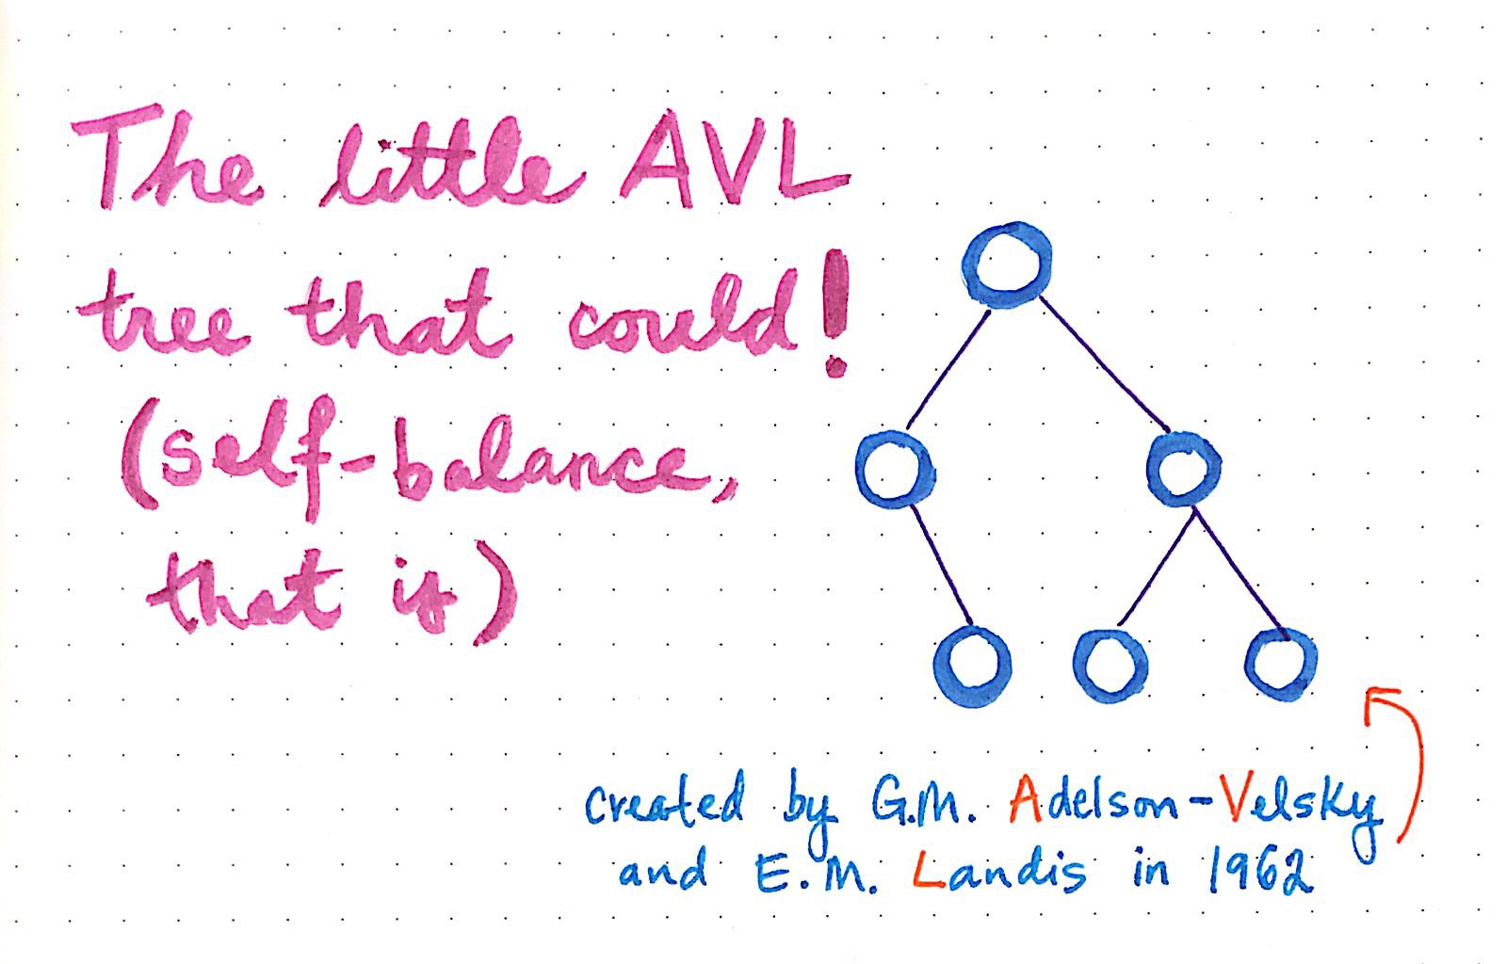
Heuristics: self-adjusting
AVL trees and Black-Red trees are both self-adjusting data structures.

Slide 10
Greedy algorithms

Slide 11
Greedy algorithm
A greedy algorithm is an algorithm that, when presented with a list of options, chooses the option that is optimal at that point in time.
The optimal choice at that point in time is the choice that offers the most obvious and immediate benefit.
The choice of option does not consider additional subsequent options, and may or may not lead to an optimal solution.

Slide 12
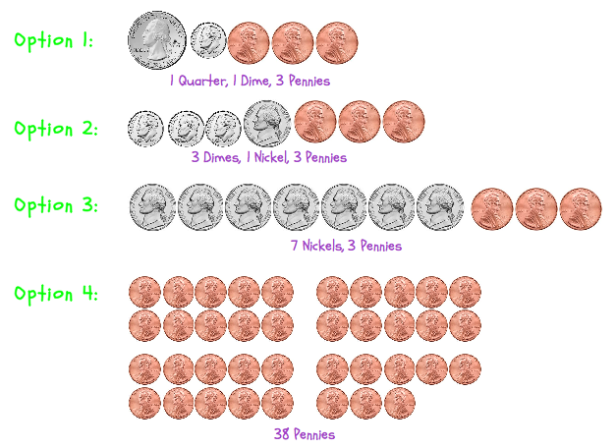
Greedy algorithm - make change

Slide 13
Greedy algorithm make change
Example: makeChangeMinBills.cpp

Slide 14
Greedy algorithm fractional knapsack
The fractional knapsack problem is the knapsack problem with the potential to take each item a fractional number of times
Example: A 4 pound, $10 item could be taken 0.5 times to fill a knapsack with a 2 pound weight limit. The resulting knapsack would be worth $5.
GREEDY 0-1 Knapsack problem is not optimal but GREEDY fractional Knapsack is!
Example: fractionalKnapsack.cpp

Slide 15
Greedy Algorithm Activity Selection problem
You are given a list of possible available activities. Each activity has a start time and a finish time.
The goal is to build the largest possible set of activities without time conflicts.
Let’s say the following activities are going to be available for participants at the Global Game Jam:
Activity 1 Getting Started with Game Dev start: 1am finish: 2am
Activity 2 How to Build a Card Game start: 3am finish: 4am
Activity 3 Sid Meier talk: Civilization start: 12am finish: 6am
Activity 4 Todd Howard talk: Elder Scrolls start: 5am finish: 7am
Activity 5 Creating a Game in Unity start: 8am finish: 9am
Activity 6 Designing Assets for your Game start: 5am finish: 9am

Slide 16
Greedy Algorithm Activity Selection problem
Step One: Sort activities in ascending order by finish time.
Let’s say the following activities are going to be available for participants at the Global Game Jam:
Activity 1 Getting Started with Game Dev start: 1am finish: 2am
Activity 2 How to Build a Card Game start: 3am finish: 4am
Activity 3 Sid Meier talk: Civilization start: 12am finish: 6am
Activity 4 Todd Howard talk: Elder Scrolls start: 5am finish: 7am
Activity 5 Creating a Game in Unity start: 8am finish: 9am
Activity 6 Designing Assets for your Game start: 5am finish: 9am

Slide 17
Greedy Algorithm Activity Selection problem
First activity always gets selected.
Activity 1 Getting Started with Game Dev start: 1am finish: 2am
Activity 2 How to Build a Card Game start: 3am finish: 4am
Activity 3 Sid Meier talk: Civilization start: 12am finish: 6am
Activity 4 Todd Howard talk: Elder Scrolls start: 5am finish: 7am
Activity 5 Creating a Game in Unity start: 8am finish: 9am
Activity 6 Designing Assets for your Game start: 5am finish: 9am
Then, go through other activities one by one and if the activity has start time >= previously selected activity, then select it.
Activities 1, 2, 4, & 5 would get selected.

Slide 18
Greedy algorithm activity selection problem
Example: activitySelection.cpp

Slide 19
Greedy algorithm Dijkstra’s Algorithm
Dijkstra’s algorithm uses the greedy approach to find the shortest path to ALL vertices in a weighted, connected directed or undirected graph.
This is a single-source-shortest-path problem.
The solution is a family of paths, each leading from the source to a different vertex in the graph.

Slide 20
Greedy algorithm Dijkstra’s Algorithm
Dijkstra’s algorithm uses the greedy approach to find the shortest path to ALL vertices in a weighted, connected directed or undirected graph.
This is a single-source-shortest-path problem.
The solution is a family of paths, each leading from the source to a different vertex in the graph.

Slide 21
Greedy algorithm Dijkstra’s Algorithm
Real-Life Applications
Transportation planning
GIS (Geographic Information System ) – Google Maps!
Packet routing in communication networks

Slide 22
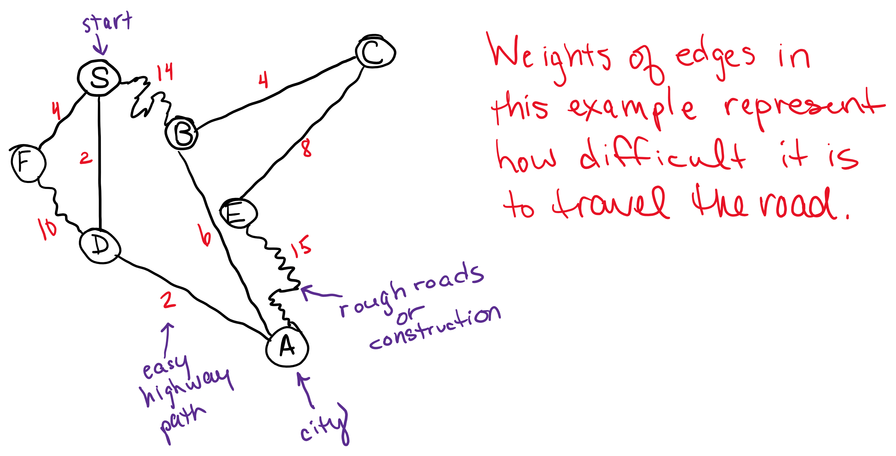
Greedy algorithm Dijkstra’s Algorithm

Slide 23
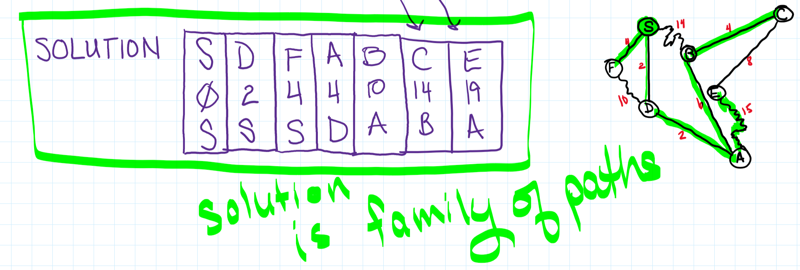
Greedy algorithm Dijkstra’s Algorithm

Slide 24
Greedy algorithms
Kruskals minimum spanning tree
Prims minimum spanning tree
Maximum flow problem (anything that has a flow or network – data, water, electricity, roads)
Huffman coding (data compression)
Traveling salesman problem
Graph coloring (making schedule, Sudoku, map coloring, etc.)
And many, many more…

Slide 25
Dynamic programming

Slide 26
Dynamic programming
Dynamic programming is a problem solving technique that splits a problem into smaller sub-problems, computes and stores solutions to sub-problems in memory, and then uses the stored solutions to solve the larger problem.
Example: Fibonacci Numbers

Slide 27
Dynamic programming Fibonacci Numbers
Fibonacci numbers are the following sequence: 0, 1, 1, 2, 3, 5, 8, 13, 21, 34, 55, 89, 144, 233, …
Notice after the 2nd number, each number in the series is the sum of the two previous numbers.
F₀ = 0
F₁ = 1
F_{N} = F_{N}-1 + F_{N}-2 for N >= 2

Slide 28
Dynamic programming Fibonacci numbers
fibonacci.cpp - non dynamic programming example
fibonacci_db.cpp – dynamic programming example

Slide 29
end

